Slide 1
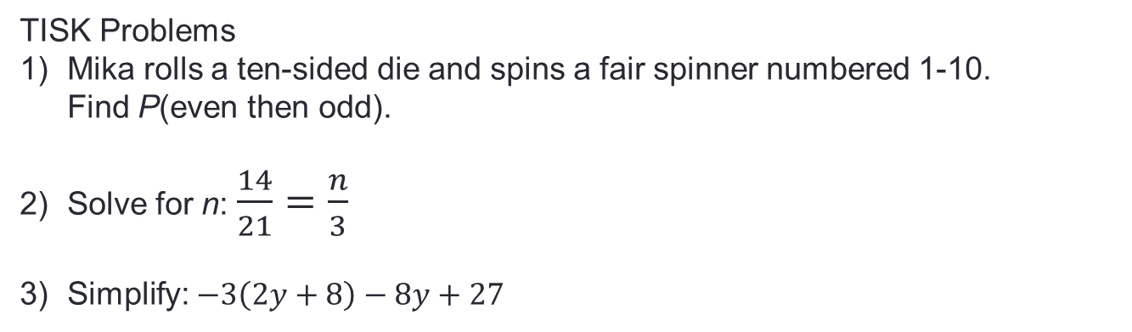
Tuesday, Nov. 13, 2012
Agenda
TISK & MM
Homework Discussion
Lesson 10-3: Equations with Variables on Both Sides
Homework: p. 510 #22-32
TISK Problems
Mika rolls a ten-sided die and spins a fair spinner numbered 1-10.
Find P(even then odd).
Solve for n: $\frac{14}{21}=\frac{n}{3}$
Simplify: $−3\left(2y+8\right)−8y+27$
There will be 2 Mental Math Questions today.
Notes:
Mental Math
1.) Start with 9 less than 8. Square it. Add the smallest prime number that’s greater than 14. Divide by -6. Triple it. (-9)
2.) Start with 100 less than 58. Divide by -7. Square it. Add the largest prime number that’s less than 16. Take the square root. Triple it. (21)

Slide 2

Homework Discussion
$x=1$
$a=7$
$x=2$
$y=−4$
$x=1$
$n=2$
$d=3$
$x=7$

Slide 3









§10.3 Equations with Variables on Both Sides
If variables are on both sides of the equation, add or subtract to get them all on one side.
$$7x+19=−2x+55$$
$$+2x$$
$$+2x$$
$$9x+19=55$$
$$−19$$
How do you decide which side to “pick on”?
$$−19$$
$$\frac{}{9}$$
$$\frac{}{9}$$
$$9x=36$$
Then, solve as usual!
$$x=4$$

Slide 4







Examples. Solve the equation.
$$80−9y=6y$$
$$+9y$$
$$+9y$$
$$\frac{}{15}$$
$$\frac{}{15}$$
$$80=15y$$
$$\frac{16}{3}=y$$

Slide 5









Examples. Solve the equation.
$$6x+22=−3x+31$$
$$+3x$$
$$+3x$$
$$9x+22=31$$
$$−22$$
$$−22$$
$$\frac{}{9}$$
$$\frac{}{9}$$
$$9x=9$$
$$x=1$$

Slide 6



Check Point. Try it on your own.
$$64−12w=6w$$
$$17−2x=14+4x$$
$$2−x=7x−14$$

Slide 7
Many Solutions & No Solutions
Sometimes, when variables are on both sides of the equal sign, the variables “disappear”.
If that happens, there are either NO Solutions or “MANY” Solutions.

Slide 8











Examples. Solve the equation.
$$4\left(x−5\right)=4x−20$$
$$4x−20=4x−20$$
No Solution is DIFFERENT from ZERO. Zero is a number (and can be a solution!) but no solution means there is NO NUMBER that will make the equation work.
$$−4x$$
$$−4x$$
$$−20=−20$$
$$x=any number$$
$$3x−9=3x+10$$
$$−3x$$
$$−3x$$
$$−9=10$$
$$x=∅$$
(this symbol means “no solution”)

Slide 9









Examples. Solve the equation.
$$4\left(1−x\right)+3x=−2(x+1)$$
$$4−4x+3x=−2x−2$$
$$4−x=−2x−2$$
$$+2x$$
$$+2x$$
$$4+x=−2$$
$$−4$$
$$−4$$
$$x=−6$$

Slide 10

















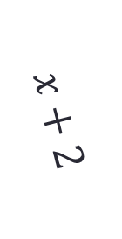






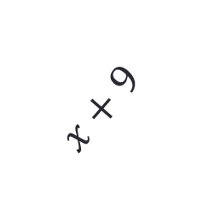





Example. Both figures have the same perimeter. Find each perimeter.
$$x−7$$
$$4x−14$$
$$=$$
$$3x+4$$
$$−3x$$
$$−3x$$
$$x$$
$$x+9$$
$$x+2$$
$$x−14=4$$
$$+14$$
$$+14$$
$$x−7$$
$$x=18$$
$$P=2l+2w$$
$$P=s_{1}+s_{2}+s_{3}$$
$$l=x$$
$$s_{1}=x−7$$
$$P=3x+4$$
$$w=x−7$$
$$s_{2}=x+9$$
$$P=3(18)+4$$
$$s_{3}=x+2$$
$$P=54+4$$
$$P=2x+2(x−7)$$
$$P=58$$
$$P=2x+2x−14$$
$$P=x−7+x+9+x+2$$
$$P=4x−14$$
$$P=3x+4$$

